Slide 1
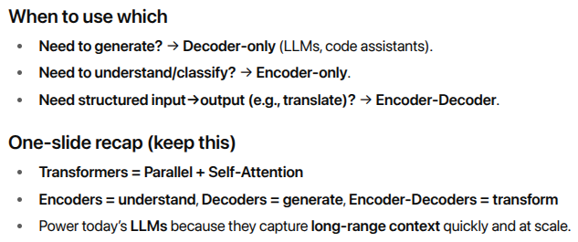
Transformer Models
files_transformers.zip

Slide 2
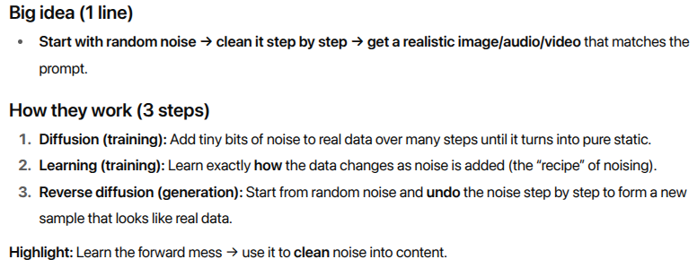
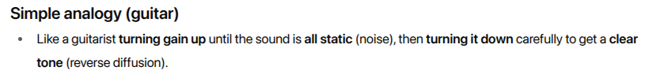
Diffusion Models

Slide 3
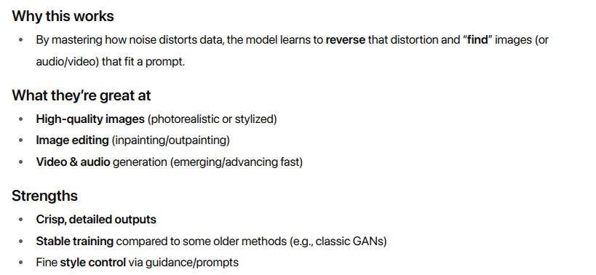
Diffusion Models

Slide 4
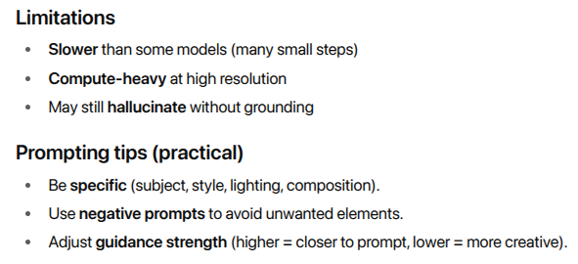
Diffusion Models

Slide 5
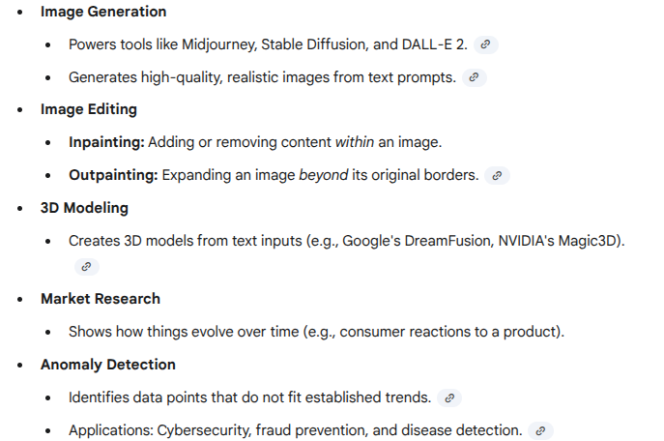
Diffusion Models – Use cases
files_diffusion_models.zip

Slide 6
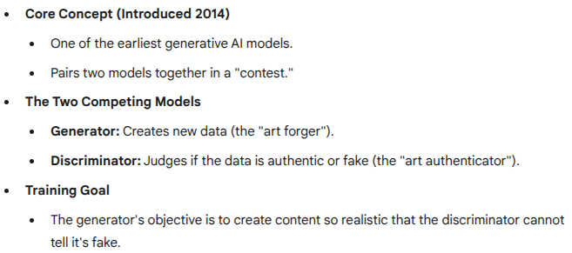
Generative adversarial networks(GANs)

Slide 7
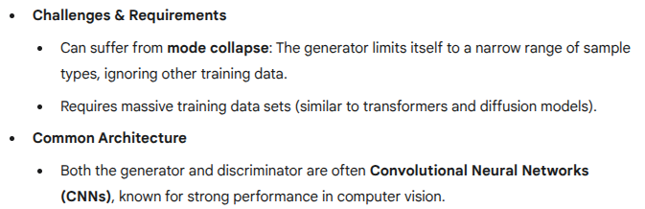
Generative adversarial networks(GANs)

Slide 8

Generative Adversarial Networks (GANs) in a simple way.

Slide 9
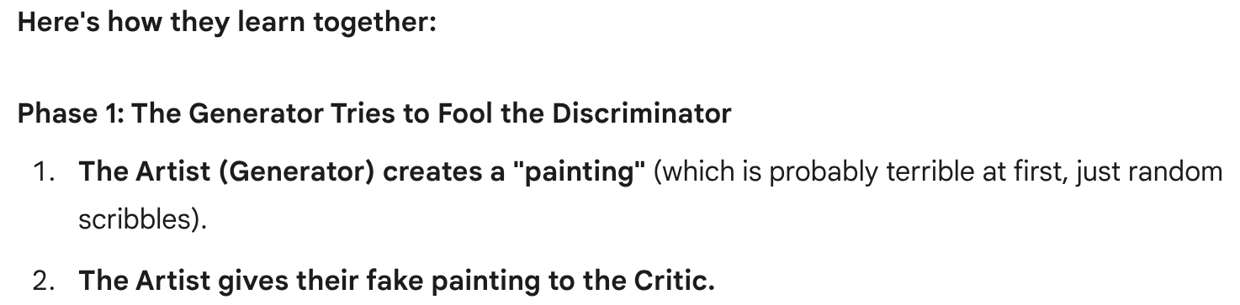
Generative Adversarial Networks (GANs) in a simple way.

Slide 10
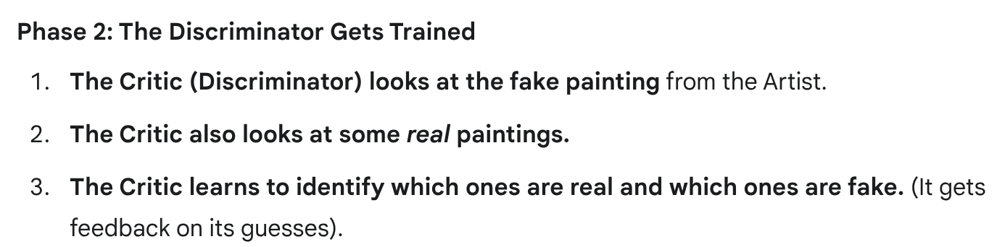
Generative Adversarial Networks (GANs) in a simple way.

Slide 11
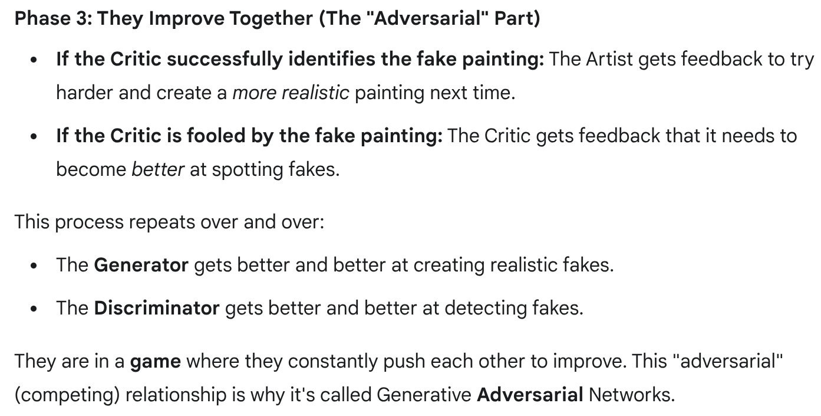
Generative Adversarial Networks (GANs) in a simple way.

Slide 12
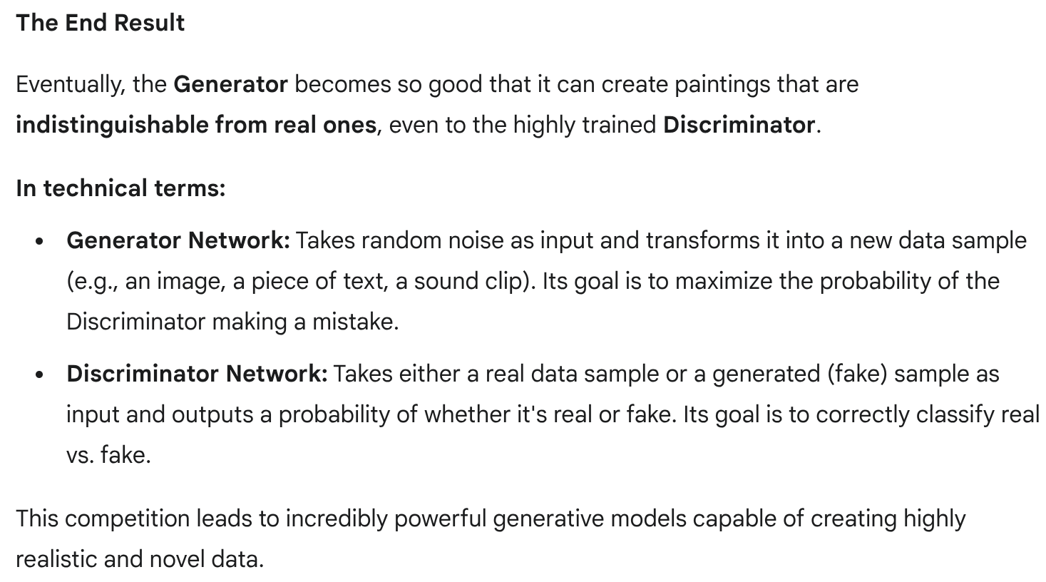
Generative Adversarial Networks (GANs) in a simple way.

Slide 13
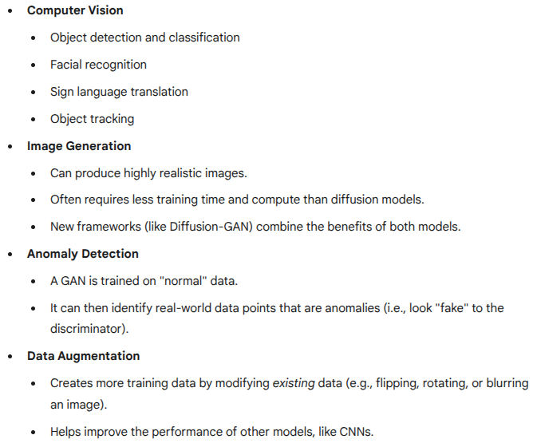
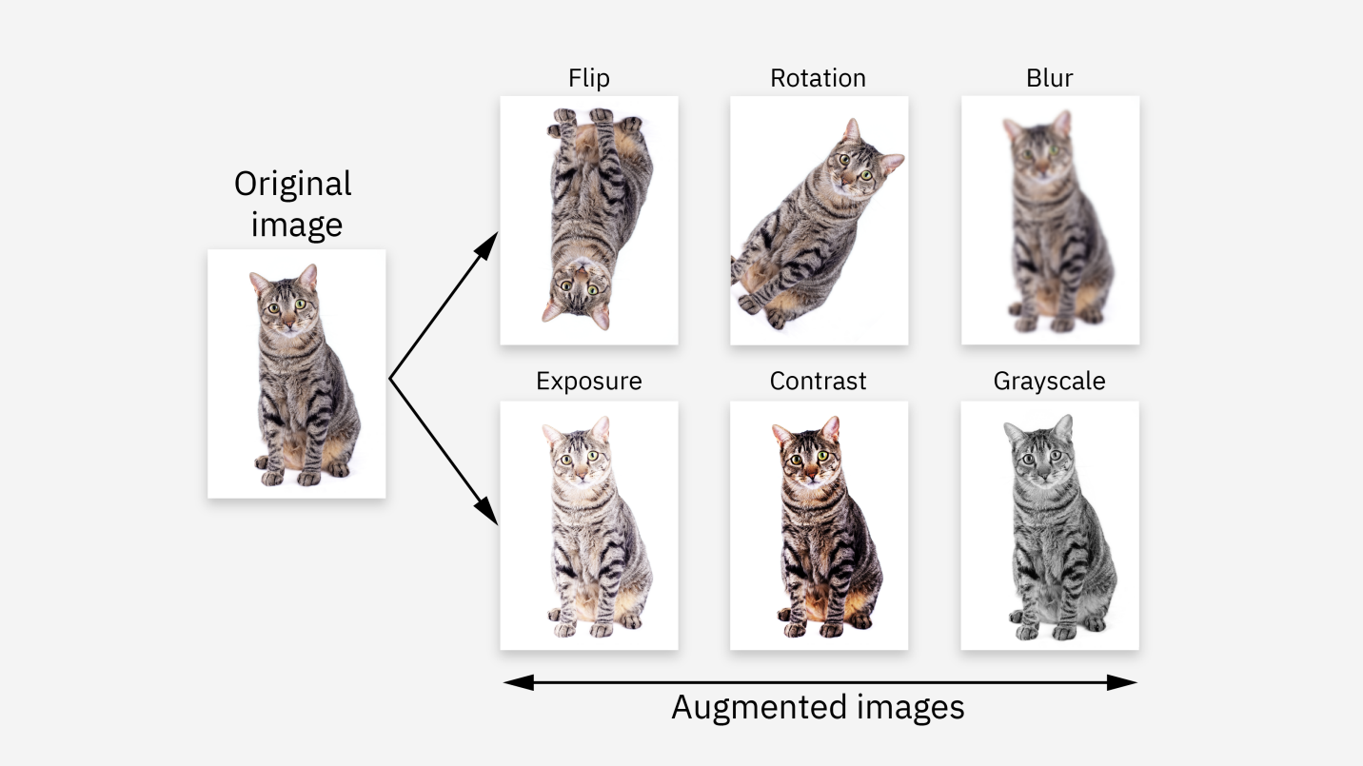
Generative adversarial networks(GANs)

Slide 14
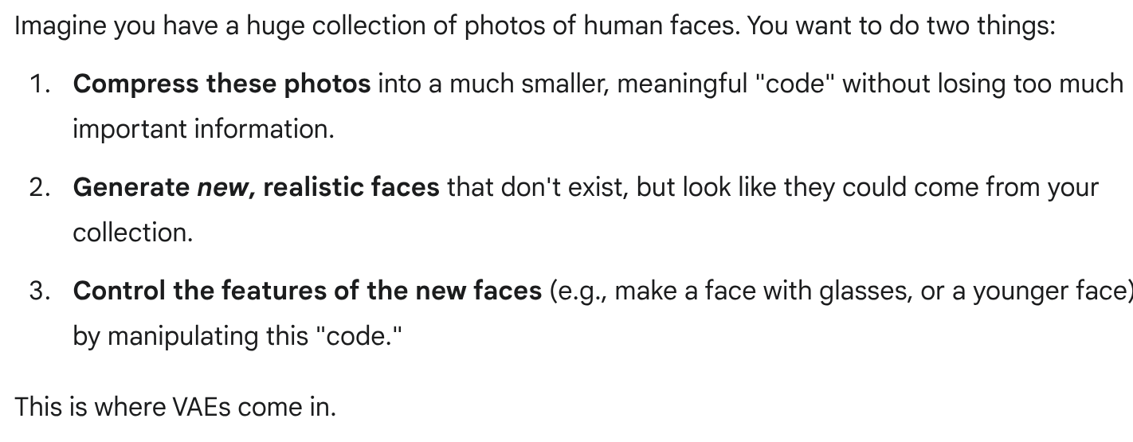
Variational auto encoders (VAEs)

Slide 15
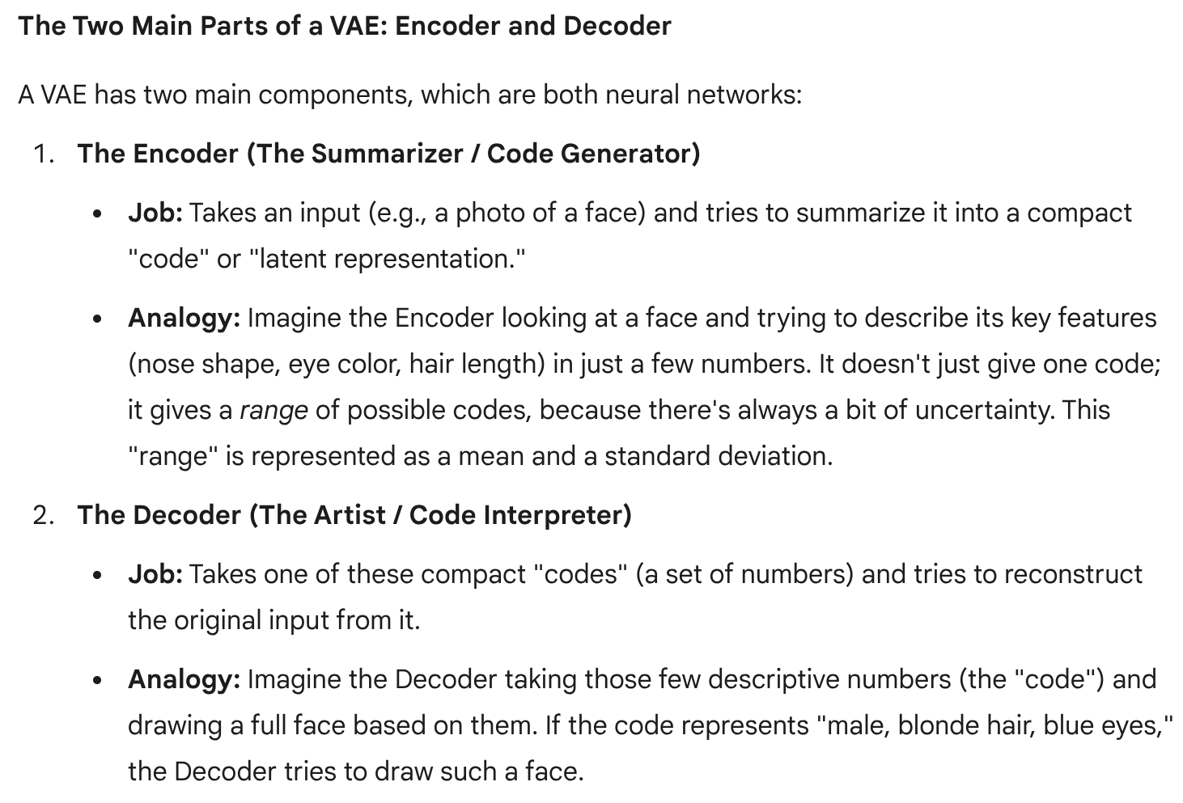
Variational auto encoders (VAEs)

Slide 16
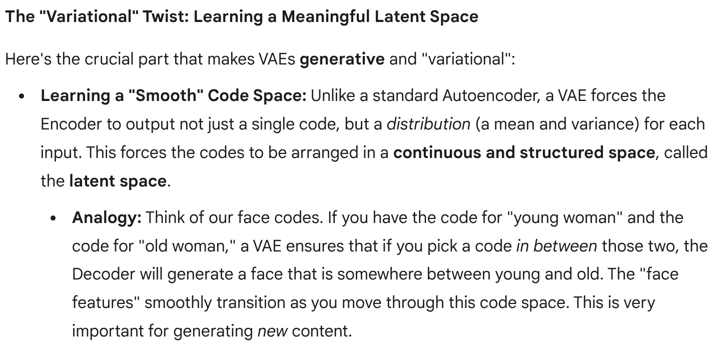
Variational auto encoders (VAEs)

Slide 17
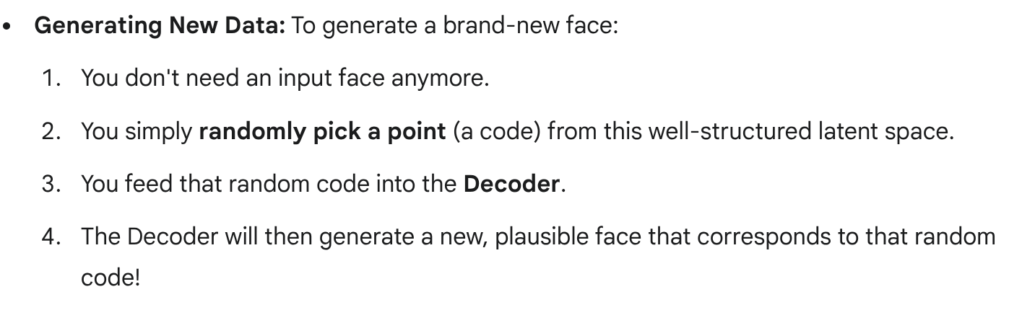
Variational auto encoders (VAEs)

Slide 18
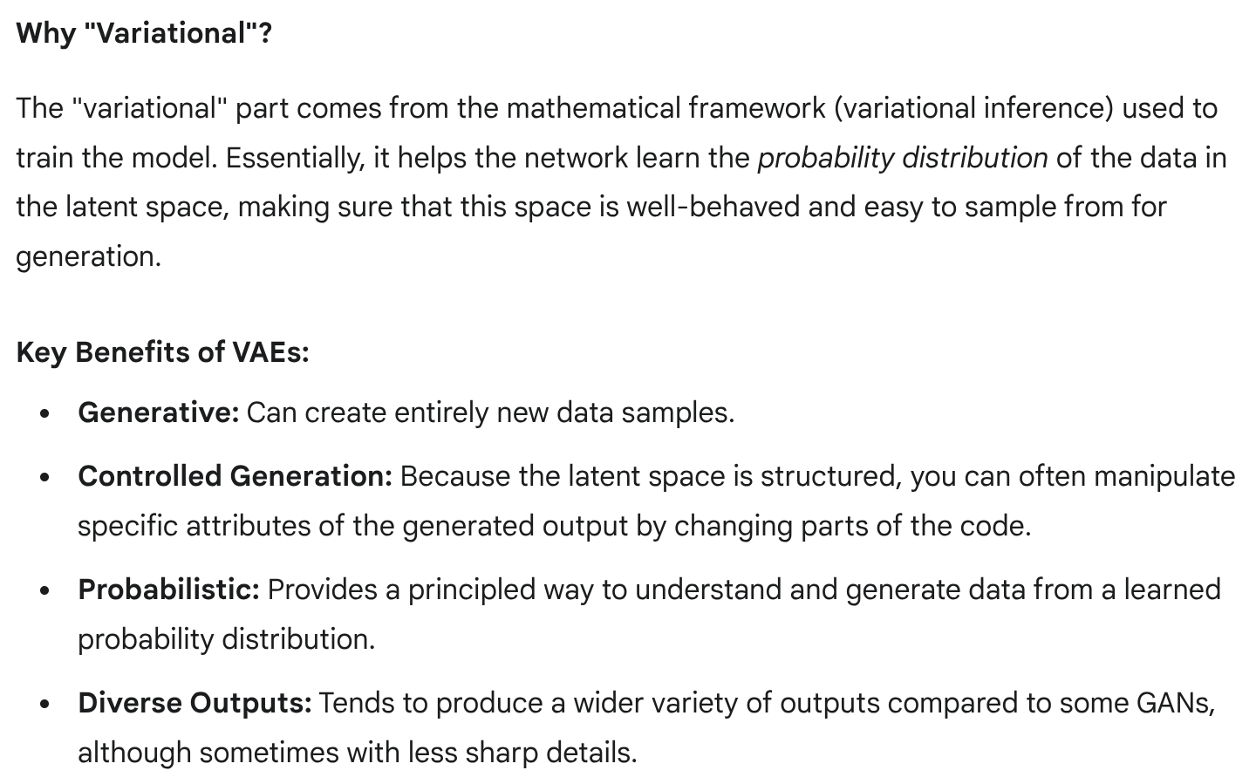

Slide 19
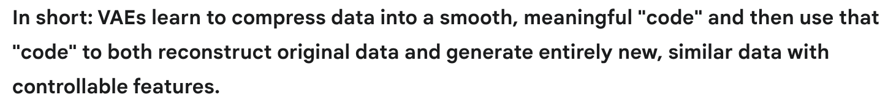

Slide 20
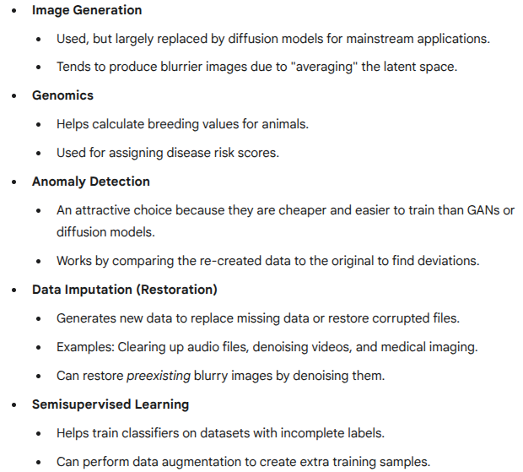
VAE use cases

Slide 21
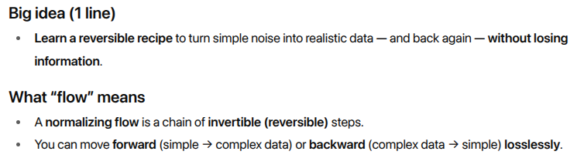
Flow-based models

Slide 22
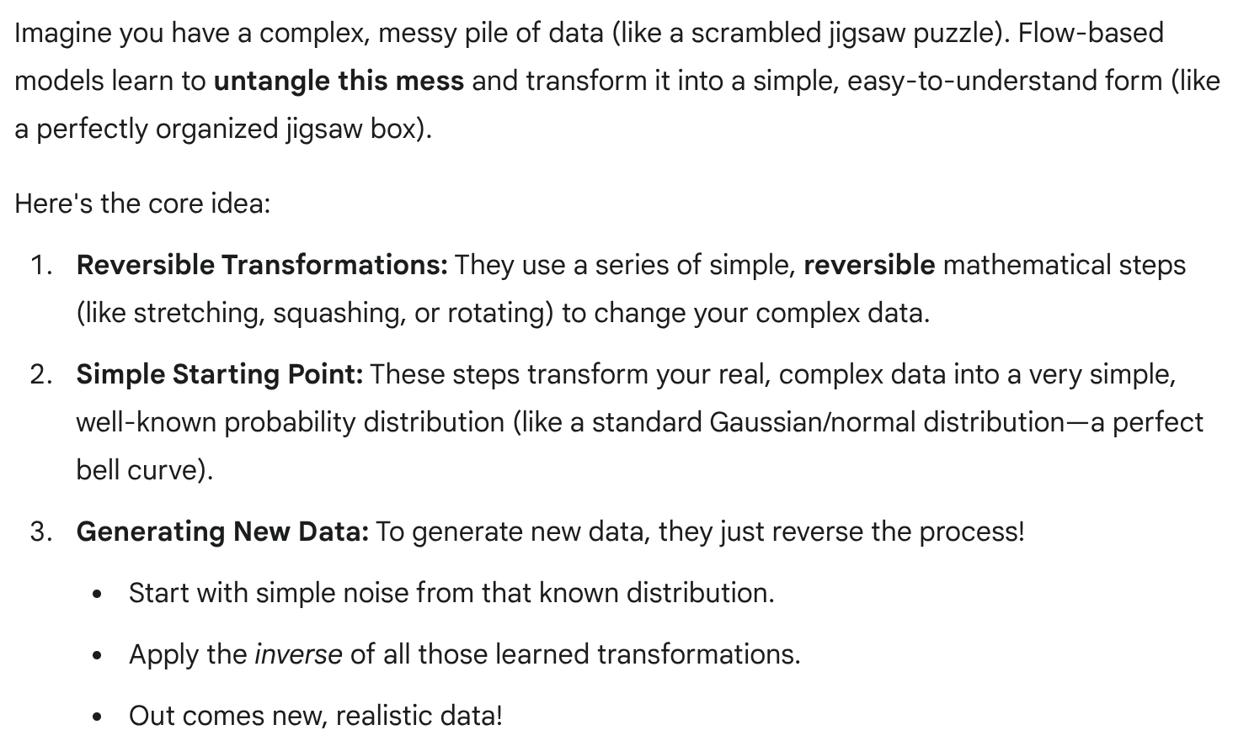
Flow-based models

Slide 23
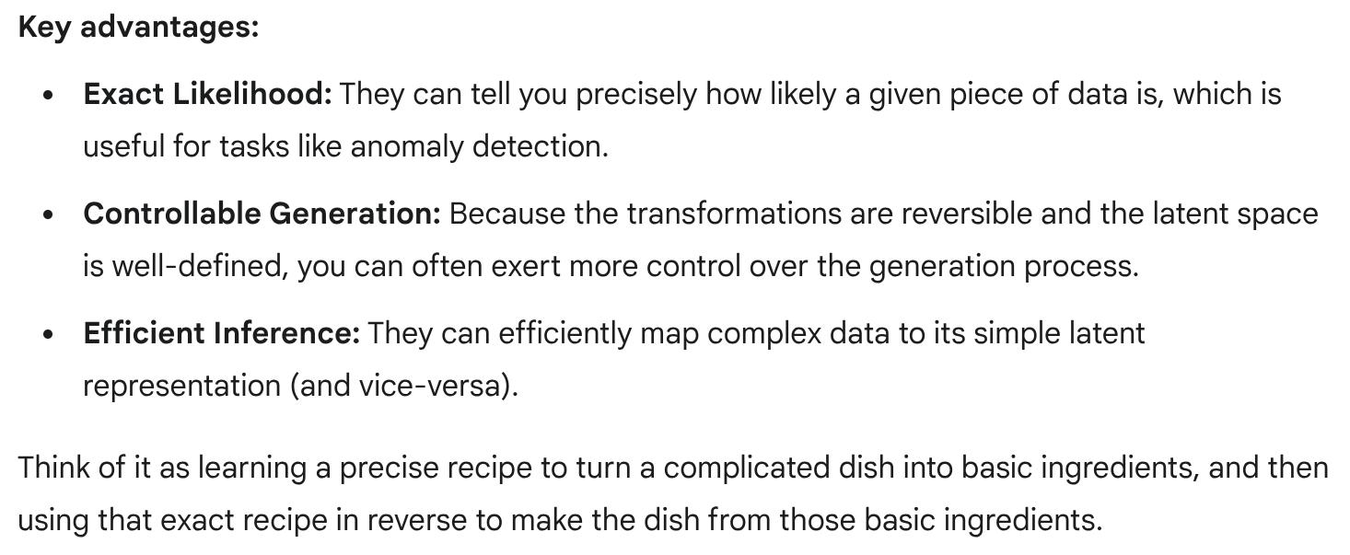
Flow-based models

Slide 24
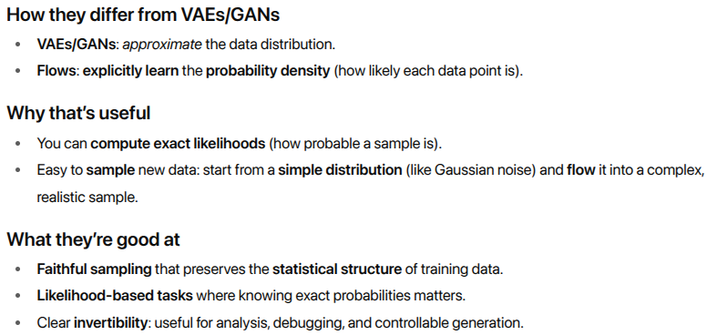
Flow-based models

Slide 25
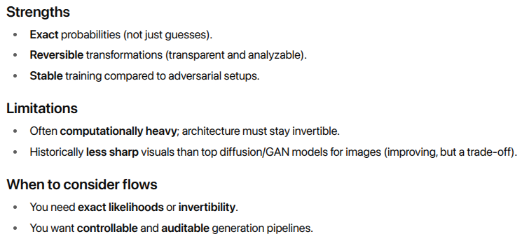
Flow-based models

Slide 26
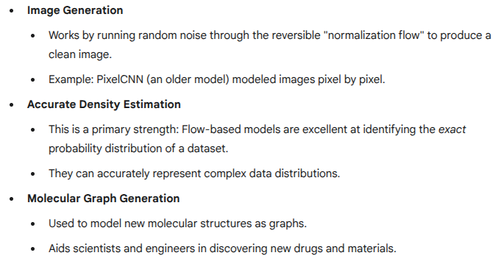
Flow-based model use cases

Slide 27
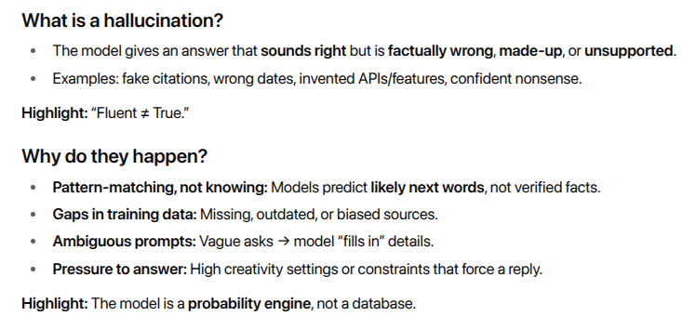

Generative models and hallucinations

Slide 28
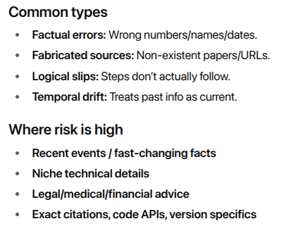
Generative models and hallucinations

Slide 29
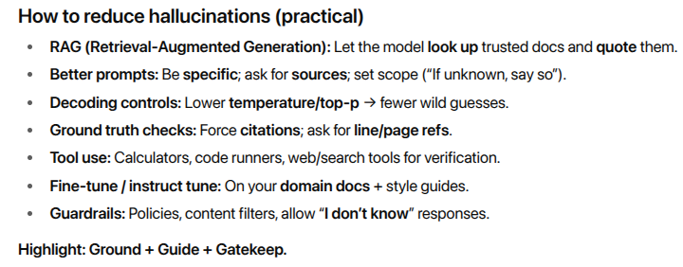
Generative models and hallucinations

Slide 30
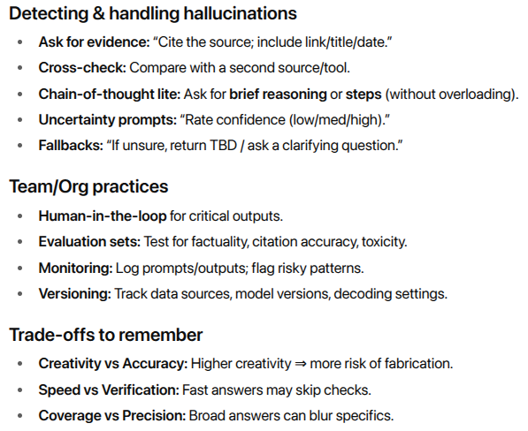
Generative models and hallucinations

Slide 31
Generative AI vs. predictive AI: What’s the difference?

Slide 32
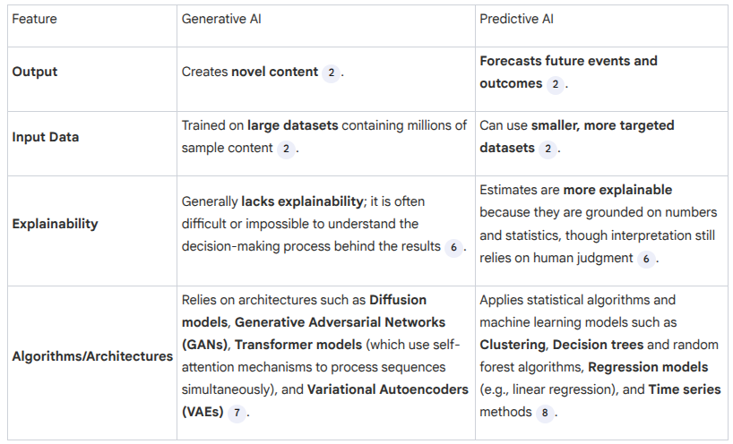
Generative AI vs. predictive AI: What’s the difference?

Slide 33
Generative AI Use cases
Generative AI Use Cases Gen AI excels in content creation and can be implemented across various industries:
• Customer service: Providing personalized responses and real-time support via chatbots and virtual agents.
• Gaming: Assisting with the creation of lifelike characters, real-world environments, dynamic animations, and visual effects.
• Healthcare: Creating synthetic data for training medical imaging systems and proposing new molecules to accelerate drug discovery.
• Marketing and advertising: Designing engaging visuals and crafting customized ad and sales copy.
• Software development: Speeding up coding and automating debugging and testing.

Slide 34
Predictive AI Use Cases
Predictive AI is commonly used in manufacturing, finance, retail, and e-commerce:
• Financial forecasting: Forecasting market trends, stock prices, and other economic factors.
• Fraud detection: Spotting suspicious transactions in real time.
• Inventory management: Controlling inventory levels by projecting sales and demand.
• Personalized recommendations: Analyzing customer behavior patterns to provide tailored suggestions.
• Supply chain management: Optimizing logistics, resource allocation, and production plans.

Slide 35


Slide 36

Welcome to the Future!
Hello everyone! Ever wondered how computers can suddenly write stories, answer complex questions, or even create art?
It's not magic, it's Generative AI and Large Language Models!
Today, we're going to peek behind the curtain.

Slide 37
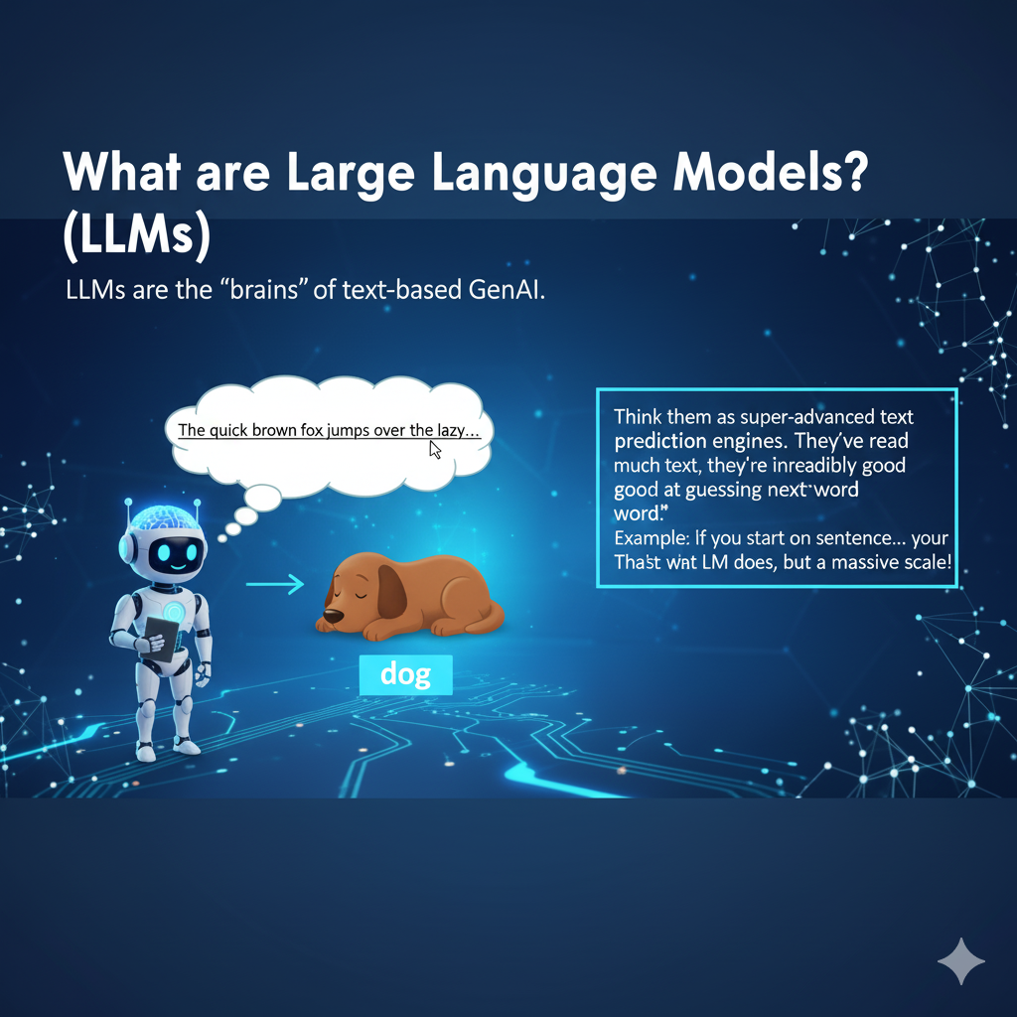
What are Large Language Models? (LLMs)
LLMs are the "brains" of text-based GenAI.
Think of them as super-advanced text prediction engines. They've read so much text, they're incredibly good at guessing the next word.
Example: If you start a sentence... "The quick brown fox jumps over the lazy..." ...your brain instantly thinks "dog"! That's what an LLM does, but on a massive scale.

Slide 38
Common terms used in LLM (Large Language Model) & LMM (Large Multimodal Model):
Token: The smallest unit (word, character, or symbol) that an LLM processes in text input and output.​
Tokenization: The process of dividing text into discrete tokens for model processing.​
Parameter: A variable adjusted during training to improve model predictions.​
Weight: A specific type of parameter that determines the importance of connections in the model’s neural network.​
Inference: The stage where a trained model generates predictions or responses based on new data.​
Prompt: Input text or instruction given to the model to generate specific output.​
Context Window: The maximum number of tokens the model can consider at one time.​
Fine-tuning: Adapting a pre-trained model for specialized tasks using additional data.​
Embedding: Numerical representation of tokens that lets models understand meaning and relationships.​
Architecture: The structure and design of the neural network underlying the model.​
Few-shot Learning: The ability of a model to perform tasks with minimal examples provided.​
Zero-shot Learning: Model’s capability to perform new tasks without task-specific training examples.​
Multimodal: Handling and integrating data from multiple types (e.g., text, image, audio) in LMMs.​

Slide 39
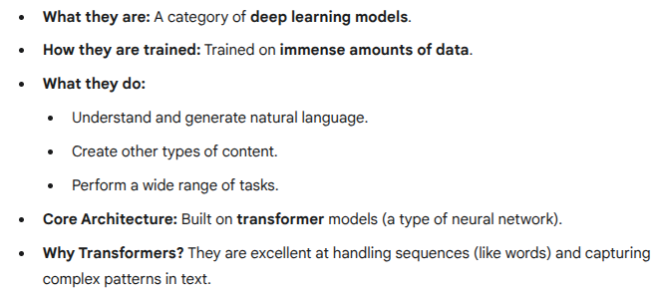
What are Large Language Models? (LLMs)
LAB - Installation ollama
LAB - ollama_egs.md

Slide 40
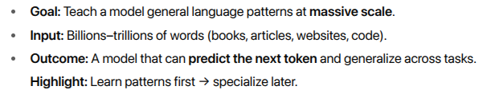
Pretraining LLM’s – BIG picture

Slide 41
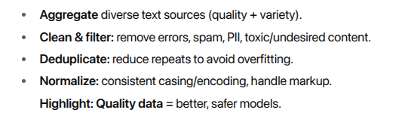
Data Collection & Cleaning

Slide 42
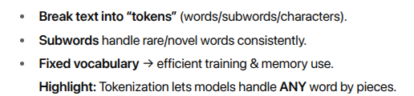
Tokenization (Making Text Machine-Readable)

Slide 43
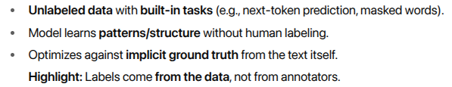
Self-Supervised Learning (No Manual Labels)

Slide 44
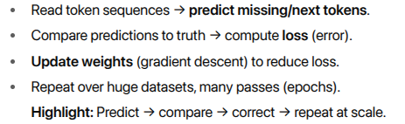
Training Loop (Conceptual)

Slide 45
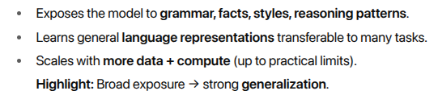
Why Pretraining Works

Slide 46
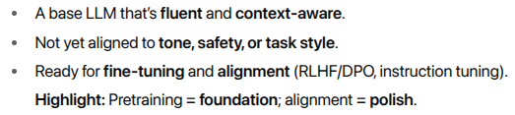
What You Get After Pretraining

Slide 47
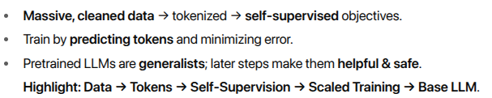
Key Takeaways

Slide 48
Self Attention

Slide 49
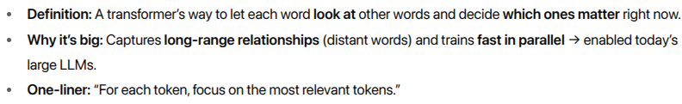
What is Self Attention ?

Slide 50
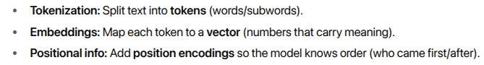
What is Self Attention ?
From Text to Vectors

Slide 51
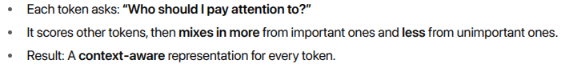
What is Self Attention ?
Core Idea (Intuition)

Slide 52
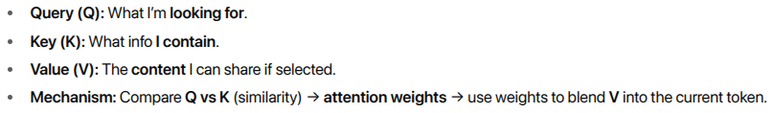
What is Self Attention ?
Q, K, V (Plain English)

Slide 53
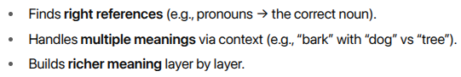
What is Self Attention ?
Why It Works

Slide 54
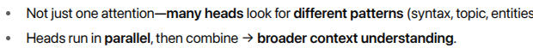
What is Self Attention ?
Multi-Head Attention (Simple)

Slide 55
What is Self Attention ?
Efficiency vs RNNs

Slide 56
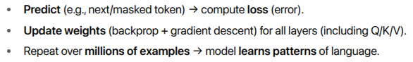
What is Self Attention ?
Training (Conceptual)

Slide 57
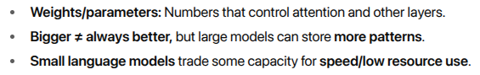
What is Self Attention ?
Parameters & Model Size

Slide 58
What is Self Attention ?
What You Get
Learned grammar, facts, styles, reasoning structures.
Ability to use context (near and far) to generate better outputs.
Quick Example
Sentence: “The trophy didn’t fit in the suitcase because it was too small.”
Self-attention can link “it” to “suitcase” (not “trophy”) based on context.

Slide 59

Fine-tuning large language models
Fine-Tuning LLMs: The Idea
LAB - filesllm_fine_tuning_03.tgz
- Colab Model lab( unsloth)

Slide 60
Fine-tuning large language models
Supervised Fine-Tuning (SFT)
Input: Labeled pairs (prompt → ideal answer).
Goal: Make outputs closer to examples you provide.
Use for: Summarization, classification, Q&A, customer replies.
Pros: Simple, data efficient, fast vs training from scratch.
Example: General LLM → fine-tune on legal Q&As → legal chatbot.
Highlight: “Show & tell” the model how to answer.

Slide 61
Fine-tuning large language models
RLHF (Reinforcement Learning from Human Feedback)
What: Humans rank multiple model answers; model learns to prefer higher-ranked ones.
Use for: Alignment (helpful, safe, on-brand), style (casual/formal/humorous).
Pros: Shapes tone and behavior beyond raw correctness.
Notes: Often run after SFT to refine responses.
Highlight: Teach preferences, not just correctness.

Slide 62
Fine-tuning large language models
Reasoning Models (Multi-Step Thinking)
Problem: SFT copies patterns but may lack reasoning.
Idea: Use RL and special training to encourage step-by-step problem solving (“reasoning traces”).
Use for: Math/logic, multi-hop Q&A, planning.
Outcome: More structured, explainable answers.
Highlight: From “answer directly” → “think then answer.”

Slide 63
Fine-tuning large language models
Instruction Tuning (Follow Directions Better)
What: Train on datasets of user-like instructions + good responses.
Why: Base LLMs aren’t naturally optimized for following instructions.
Use for: Conversational agents, tools that must follow clear prompts.
Benefit: Higher obedience to user intent; fewer off-track replies.
Highlight: “Do what I say,” not just “know language.”

Slide 64
Fine-tuning large language models
Picking the Right Method
Need task accuracy? → SFT
Need tone/safety/brand voice? → RLHF
Need step-by-step logic? → Reasoning training
Need better instruction following? → Instruction tuning
Highlight: You can combine them (e.g., SFT → RLHF).

Slide 65
Fine-tuning large language models
Data & Quality Tips
Curate examples: Clear, diverse, representative.
Balance style + facts: Include preferred tone and correct content.
Evaluate: Use held-out tests; check factuality, safety, style.
Highlight: Good data > more data.

Slide 66
Fine-tuning large language models
Practical Outcomes
Domain fit: Medical/legal/finance knowledge tone improves.
Consistency: Fewer off-style answers; more brand-aligned.
Safety: Reduced harmful or policy-breaking outputs (with alignment).
Highlight: Tailored usefulness you can trust.

Slide 67
Using large language models

Slide 68
Using large language models
How LLMs Respond (Inference)
Prompt in → tokens: Text is split into tokens and turned into embeddings.
Transformer predicts next token: Calculates probabilities for all next tokens and picks the most likely.
Repeat until done: Generates one token at a time; doesn’t “know” the full answer in advance—just best guesses step by step.

Slide 69
Using large language models
Quick Wins: Prompt Engineering
No training needed: Just craft better instructions.
Be specific: Role (“You are a…”) + task + format + constraints.
Example: “Answer in the voice of a trained healthcare professional” (avoid using for medical advice).
Add context: Provide examples, definitions, or data in the prompt.

Slide 70
Using large language models
Output Controls (Creativity vs. Safety)
Temperature: Lower = safer/more consistent; higher = more creative.
Top-k / Top-p: Limit to most-likely tokens to improve coherence.
Tip: Start low/medium for accuracy; raise for brainstorming.

Slide 71
Using large language models
Context Window (How Much It Can “See”)
Definition: Max tokens the model can use at once (prompt + its own drafts).
Bigger windows: Enable long docs, large code files, long chats.
Tip: Keep key facts near the end of the prompt (recency helps).

Slide 72
Using large language models
RAG: Retrieval-Augmented Generation
What it is: Connect the LLM to external knowledge (docs, DBs, APIs).
How it works: Retrieve relevant info → stuff into context → generate.
Benefits: Current, accurate, source-grounded answers without retraining.
Example: Pull today’s weather from a live database and include it in the reply.

Slide 73
Using large language models
When to Use What
Just need general knowledge or drafting? → Prompt engineering + output controls.
Need domain accuracy or recency? → RAG (add your docs/APIs).
Need permanent behavior/style changes? → Consider fine-tuning later.

Slide 74
Using large language models
Good Habits & Safety
Structure prompts: role → task → context → format → constraints.
Ask for sources: “Cite references.” / “If unsure, say so.”
Check sensitive domains: Legal/medical/finance → human review.
Log & test: Keep examples; iterate prompts; monitor quality.

Slide 75
Deploying LLMs

Slide 76
Deploying LLMs
Deploying LLMs: Big Picture
Building from scratch is hard: huge data + GPUs + energy + experts.
Practical path: use pretrained models via APIs or open-source checkpoints.
Outcome: Faster time-to-value for chatbots, search, automation, agents.

Slide 77
Deploying LLMs
Build vs. Use
Build (from scratch): max control, massive cost/complexity.
Use (pretrained): fast start, low risk; customize with prompting, RAG, fine-tuning.
Hybrid: start with use → add targeted fine-tuning later.

Slide 78
Deploying LLMs
How to Access Models
APIs (hosted): Simple, scalable; vendor handles updates.
Open-source models: Run locally or cloud; more control/privacy.
Marketplaces: GitHub, Hugging Face, Kaggle = models + datasets + examples.

Slide 79
Deploying LLMs
Where to Deploy
Cloud (managed): quickest to scale.
Self-hosted (on-prem/private cloud): data control, compliance.
Edge/on-device (small LMs): low latency, offline, privacy.

Slide 80
Deploying LLMs
Core App Patterns
Chatbots & copilots: assist users, answer questions.
Knowledge retrieval (RAG): ground answers in your docs/DBs/APIs.
Automation tools: summarize, extract, classify, route tickets.
Structured outputs: generate JSON/SQL/code for downstream systems.

Slide 81
Deploying LLMs
Agentic Systems (LLMs that “do”)
Add tools: memory, APIs, planners, schedulers.
Examples: book a flight, create a ticket, run a workflow.
Guardrails: permissions, human-in-the-loop, audit logs.
llama_agentic_demo.py

Slide 82
Deploying LLMs
Data, Privacy & Security
PII handling: redact/encrypt, least-privilege access.
Isolation: dedicated VPCs, private endpoints.
Content filters & policy checks: safety before returning outputs.
Compliance: SOC2/ISO/HIPAA/PCI as required.

Slide 83
Deploying LLMs
Performance & Cost Levers
Model choice: smallest that meets quality (S/M/L tiers).
Quantization & distillation: faster/cheaper inference.
Batching & caching: reuse responses/embeddings.
Prompt size control: trim context; use retrieval over stuffing.

Slide 84
Deploying LLMs
Observability & Quality
Logging & analytics: prompts, latencies, costs, feedback.
Eval suites: accuracy, faithfulness, toxicity, latency.
A/B tests & guardrails: detect regressions; block unsafe output.
Feedback loops: thumbs-up/down, error reports → continuous improvement.

Slide 85
Deploying LLMs
MLOps for LLMs
Versioning: model, prompts, retrieval index, tools.
CI/CD: test prompts, evals on every change.
Retrieval freshness: scheduled re-index, document lifecycle.
Rollback plan: switch models/prompts quickly if issues.

Slide 86
Deploying LLMs
Fine-Tuning Options
Prompt engineering: fastest; no training.
Adapters/LoRA: light training on your data.
Full fine-tune: max control; higher cost/ops burden.

Slide 87
Deploying LLMs
Rollout Checklist
Use case & success metrics defined.
Data sources approved + RAG set up.
Safety & compliance reviewed.
Latency/cost targets met in load test.
Monitoring & on-call in place; fallbacks ready.

Slide 88
Large language model use cases

Slide 89

LLM Use Cases: What They Can Do

Slide 90

Evaluating LLMs

Slide 91

Evaluating LLMs

Slide 92

Evaluating LLMs

Slide 93


Slide 94


Slide 95


Slide 96


Slide 97


Slide 98
Reasoning Models

Slide 99


Reasoning Models

Slide 100


Reasoning Models

Slide 101

Reasoning Models

Slide 102

Reasoning Models

Slide 103

Reasoning Models

Slide 104
Instruction Tuning

Slide 105

Instruction Tuning
“Teach the model how to be told what to do.”

Slide 106


Instruction Tuning

Slide 107

Instruction Tuning
{
"instruction": "Summarize OAM alarms between 14:00–15:00, Zone-A; include counts by code.",
"input": "…(log slice)…",
"output": "RRC_ATT_FAIL: 23; HO_FAIL_SPIKE: 11; Notes: PRB>80 on CELL-101."
}

Slide 108
Instruction Tuning
Telecom-specific use cases
Call Log Q&A: “List top 3 causes of drops 14:00–15:00 in Zone-A; cite evidence.”
OAM Anomaly Triage: “Label anomaly → suggest remediation playbook.”
Log Correlation: “Correlate call/OAM/counters; produce RCA summary with citations.”
Auto Config Generator: “Emit CELL config YAML; validate against policy schema.”
Ticket Dedup/Route: “Normalize title; map to service; route with rationale.”
LAB - telecom_analysis_app
- telecom_custom_prompts.tar.gz
telecom_logs_samples.zip

Slide 109
Instruction Tuning
{
"codes": {"RRC_ATT_FAIL": 23, "HO_FAIL_SPIKE": 11},
"top_causes": ["PRB>80 on CELL-101", "Neighbor list mismatch"],
"next_steps": ["Audit neighbors", "Retune HO margins", "Capacity review CELL-101"]
}
Good output:

Slide 110
LLM Parameters

Slide 111

LLM Parameters - defined

Slide 112
Types of LLM parameters
LLM parameters can be sorted into three primary categories:
Weights
Biases
Hyperparameters

Slide 113
What an LLM learns and how it learns.
Big Picture: Parameters vs. Hyperparameters
Core Concept: An LLM is a giant network. We need to teach it (train it) and control how it learns.
Parameters (Weights & Biases)
What they are: The internal knowledge of the model.
Who sets them: The model itself learns them from data during training.
Analogy: The recipe ingredients and steps. They are the result of testing and finding out what works (e.g., "3 cups of flour," "1 tsp of salt").
Hyperparameters
What they are: The settings for the training process.
Who sets them: The human engineer before training starts.
Analogy: The oven settings. We decide to "bake at $350^{\circ}$F for 40 minutes." These settings control how the recipe (the parameters) gets cooked.

Slide 114
Deep Dive: Parameters - WEIGHTS
What are they?
Numbers that define the strength and importance of the connection between words (or concepts).
They are the vast majority of all parameters (billions of them!).
Weights can be positive (excitatory) or negative (inhibitory).
Simple Analogy: Word Association
Think of weights as the strength of the "string" connecting two words.
The string between "The capital of France is" and "Paris" has a very strong, positive weight.
The string between "The capital of France is" and "Tokyo" has a strong, negative weight.
Simple Use Case: Autocomplete
When you type "I'd like a cup of...", the model predicts "coffee."
This is because the weights it learned from reading billions of sentences create a strong, positive connection from the phrase "cup of" to the word "coffee."

Slide 115
Deep Dive: Parameters - BIASES
What are they?
An extra number added to the calculation.
A bias provides a "default tilt" or "baseline preference" for a word.
It helps the model decide how easy it is for a word to be chosen, regardless of the input context.
Simple Analogy: A "Head Start"
Think of a race. A bias is a "head start" given to a runner.
A high bias means a word is generally more likely to be chosen, even before we look at the weights from the input words.
Simple Use Case: Word Frequency
The word "the" is extremely common in English.
The model will likely have a high positive bias for the word "the."
This means it's always slightly "on the lookout" to use the word "the," making it easy to output. This helps the model be fluent without having to "re-learn" the commonness of "the" in every single sentence.

Slide 116
Deep Dive: HYPERPARAMETERS (The "Human" Settings)
These are the knobs we tune before training to control the learning process.
Example 1: Learning Rate
What it is: How fast the model updates its weights.
Analogy: The size of the steps you take when walking to a target.
Use Case:
Too High (Big Steps): You learn fast but might overshoot the best answer and be unstable.
Too Low (Tiny Steps): You are very precise, but it will take forever to learn (or you might get stuck).

Slide 117
Deep Dive: HYPERPARAMETERS (The "Human" Settings)
Example 2: Number of Layers
What it is: How "deep" the model's network is.
Analogy: The number of "levels" of thinking.
Use Case:
Fewer Layers: A "shallower" model. Faster, but only good for simple tasks (e.g., simple classification)
More Layers: A "deeper" model. Can understand complex, abstract concepts (e.g., sarcasm, themes, programming logic).

Slide 118
Summary: Putting It All Together
Hyperparameters (Set by Humans):
The "oven settings" (e.g., Learning Rate, Number of Layers).
They control the environment for learning.
Parameters (Learned by Model):
The "perfected recipe" that results from training.
Weights: The strength of connections ("France" $\rightarrow$ "Paris").
Biases: The default preference for a word (e.g., "the" is common).
Final Thought: Billions of Parameters (the knowledge) are "cooked" using a few Hyperparameters (the settings).

Slide 119

Notable LLM parameters

Slide 120

Notable LLM parameters

Slide 121
What is LLM customization ?
What is LLM customization?
LLM customization, or customization, is the process of adapting a pre-trained LLM to specific tasks.
The LLM customization process involves selecting a pre-trained model, also known as a foundation model, then tailoring the model to its intended use case.

Slide 122
LLM customization - Adapting General Models for Specific Needs
Overview of the Workflow
Goal: Apply generalized LLMs to specific contexts.
Core Idea: Transform a broad "foundation model" into a specialized tool.
Key Steps: A structured, iterative process for optimal results.

Slide 123
What is LLM customization ?
Step 1: Data Preparation
Objective: Ensure the model learns from relevant and high-quality information.
Action: Collect and assemble a domain-specific training dataset.
Importance: High-quality, relevant data leads to accurate and useful model responses.
Analogy: You can't train a chef to make French cuisine with a cookbook for Italian food.

Slide 124
LLM Customization
Step 2: Model Selection
Objective: Choose the right foundation model for your project's needs.
Considerations:
Size: Larger models (more parameters) for complex tasks, smaller for efficiency.
Effectiveness: How well it performs on general benchmarks.
Computational Resources: GPU/CPU requirements, memory.
Architecture: The underlying design (e.g., Transformer).
Key: Understand both the project goals and the model's limitations.

Slide 125
Step 3: Model Customization
Objective: Specialize the chosen foundation model.
Action: Apply a specific customization method (e.g., fine-tuning, RAG, prompt engineering).
Result: Model output is tailored to specific "downstream tasks."
Requirement: Developers need a deep understanding of the foundation model and the chosen customization method.

Slide 126
Step 4: Iteration
Objective: Optimize performance through gradual adjustments.
Approach: Implement changes in small, step-by-step processes.
Benefit: Allows developers to measure the effect of each change and inform subsequent adjustments.
Avoid: Large, sweeping changes that make it hard to pinpoint effective modifications.

Slide 127
LLM Testing
Step 5: Testing
Objective: Validate model performance before real-world deployment.
Action: Thoroughly test the model after training is complete.
Key Checks:
Effectiveness: Are the adaptations working as intended?
Catastrophic Forgetting: Has the model retained its general knowledge while learning new specifics?
Goal: Ensure reliable and consistent performance.

Slide 128
LLM Deployment
Step 6: Model Deployment
Objective: Make the custom model available for practical use.
Action: Deploy the model into its production environment.
Examples: Integrated into an AI-powered software application, exposed via an API.
Outcome: The specialized LLM is now ready for specific use cases in the real world.

Slide 129
LLM customization techniques

Slide 130
Prompt Engineering vs. Fine-Tuning vs. RAG
The Core Idea: Adapting a General Model
Problem: Foundation LLMs are generalists. They know a lot about everything but are not experts in your specific needs.
Goal: We need to adapt this general model to excel at specific tasks, understand a unique style, or use private data.
Analogy: You've hired a brilliant, "know-it-all" college graduate (the LLM). Now you need to train them for a specific job at your company.

Slide 131
Prompt Engineering
Method 1: Prompt Engineering
What it is: The art of crafting detailed instructions (the prompt) to get the exact response you want. You are not changing the model.
Analogy: Giving the new hire very clear, step-by-step instructions for a task. You're not re-training them, just being an excellent manager.
Bad Prompt: "Write about our new product."
Good Prompt: "Act as a marketing copywriter. Write a 50-word product description for a 'Model-X' e-bike. Focus on its long battery life and sleek design. Use an enthusiastic and exciting tone."
Simple Use Cases:
Generating marketing copy in a specific style.
Summarizing a meeting transcript into bullet points.
Reformatting text (e.g., turning a paragraph into a JSON).
Best For: Quick, cheap, and simple tasks.

Slide 132
Fine Tuning
Method 2: Fine-Tuning
What it is: Re-training a small part of the LLM on a new, specialized dataset. This fundamentally changes the model's weights (its "knowledge" or "behavior").
Analogy: Sending the new hire to a specialized training course. They learn a new skill or style (e.g., legal writing, medical terminology) and it becomes part of their core knowledge.
Process:
Create a dataset of high-quality examples (e.g., 500 prompt/response pairs in your desired style).
"Train" the model on this data, slightly adjusting its internal parameters.
Simple Use Cases:
Creating a chatbot that always speaks in your brand's unique voice.
Building a model that is an expert at a specific domain (e.g., classifying legal documents).
Adapting a model to a new language or style (e.g., writing like Shakespeare).
Best For: Teaching a model a new skill, style, or behavior.

Slide 133
RAG - Retrieval-Augmented Generation
RAG_use_case.tgz
Method 3: Retrieval-Augmented Generation (RAG)
What it is: Giving the LLM "open-book access" to your private data. The model's knowledge is not changed. Instead, it "looks up" relevant info before answering.
Analogy: Giving the new hire access to the company's internal wiki or database. When asked a question ("What's our Q3 sales goal?"), they don't guess—they look it up first and then give you an answer based on what they found.
Process:
A user asks a question.
The system retrieves relevant documents from your database (e.g., PDFs, emails).
The system "augments" the prompt, secretly adding the retrieved info as context.
The LLM generates an answer based on this fresh information.
Simple Use Cases:
A customer support bot that can answer specific questions about a user's order history.
A "Chat with your data" tool for employees to ask questions about internal HR policies or project documents.
Best For: Answering questions using private, new, or rapidly changing information.

Slide 134
Choice ?
Summary: Which One to Choose?
Prompt Engineering:
Use When: You need to control the output format or style for a simple task.
Cost: cheapest (just time).
Fine-Tuning:
Use When: You need to change the model's core behavior or style.
Cost: 💰💰 (requires data and compute).
RAG:
Use When: You need the model to use external or private knowledge.
Cost: 💰 (requires a database and setup).

Slide 135
What is multimodal AI?

Slide 136
What is multimodal AI?
Multimodal AI refers to machine learning models capable of processing and integrating information from multiple modalities or types of data.
These modalities can include text, images, audio, video and other forms of sensory input.

Slide 137
What is Multimodal AI?
Core Concept: AI that processes, understands, and integrates multiple types of data (modalities) at once, such as text, images, audio, and sensor data.
Evolution: It's an evolution of older concepts (like audio-visual speech recognition) now supercharged by modern deep learning and generative AI.
Key Characteristics:
Heterogeneity: Different data types have unique structures (e.g., a photo is fundamentally different from a text description).
Connections: Modalities share complementary or related information.
Interactions: Modalities influence each other when processed together.
Practical Use Cases:
Analyzing medical images alongside patient text reports.
Powering autonomous vehicles by combining computer vision (sight) with other sensory inputs (like radar).
E.g ollama_tools.ipynb (Developement/notebook)

Slide 138
How It Works: Challenges & Fusion
Core Challenge: Effectively integrating diverse data types to leverage their combined strengths.
Key Technical Hurdles (and how they are solved):
Representation: How to represent varied data in a way the AI understands.
Solution: Using specialized networks (e.g., CNNs for images, Transformers for text) to create a shared "embedding space."
Alignment: How to connect elements across modalities.
Solution: Identifying connections, like matching spoken words to video frames (temporal alignment).
Reasoning: Composing knowledge from multiple sources of evidence (e.g., "seeing" a red light and "reading" the word "STOP").
Generation: Creating new, coherent multimodal content (e.g., generating an image from a text description).
Data Fusion Methods (How data is combined):
Early Fusion: Combining raw data at the very beginning.
Mid Fusion: Integrating data at various stages of processing.
Late Fusion: Processing modalities in separate models and then combining their final outputs.

Slide 139
RAG – Retrieval Augmented Generation

Slide 140

What is retrieval augmented generation (RAG)?

Slide 141
What are the benefits of RAG?
RAG empowers organizations to avoid high retraining costs when adapting generative AI models to domain-specific use cases. Enterprises can use RAG to complete gaps in a model’s knowledge base so it can provide better answers.
The primary benefits of RAG include:
Cost-efficient AI implementation
Access to current domain-specific data
Lower risk of DataLeak
Increased user trust
Expanded use cases
Enhanced developer control and model maintenance
Greater data security

Slide 142

Cost-efficient AI implementation & scaling (RAG)

Slide 143

Cost-efficient AI implementation & scaling (RAG)

Slide 144

Access to current & domain-specific data (RAG)

Slide 145


Access to current & domain-specific data (RAG)

Slide 146

Lower risk of AI hallucinations (with RAG)

Slide 147

RAG - Good Practices

Slide 148

RAG - Good Practices

Slide 149

RAG

Slide 150

RAG

Slide 151

RAG

Slide 152

RAG use cases

Slide 153

RAG use cases

Slide 154

RAG use cases

Slide 155

RAG use cases

Slide 156

RAG use cases

Slide 157
How does RAG work?

Slide 158

Components of a RAG system

Slide 159

RAG Flow

Slide 160
RAG Flow
User Q
↓
Query Understanding ──► Hybrid Retrieve (vector + keyword) ──► Rerank/Filter (ACLs, recency)
↓ │
Prompt Builder (instructions + question + top evidence chunks)
↓
LLM Generation (grounded; must cite sources; allowed to abstain)
↓
Post-Process (format, redact, guardrails)
↓
Answer + Citations ⇦ Feedback loop (clicks/ratings) ⇦ Corpus Updates & Reindex

Slide 161

What is GraphRAG?
What it is ?

Slide 162

GraphRAG

Slide 163

GraphRAG

Slide 164

GraphRAG

Slide 165


GraphRAG – When to choose ?
GraphRAG – Gotchas

Slide 166

Dia

Slide 167

Comparison

Slide 168

Faiss (Facebook AI Similarity Search)

Slide 169


Slide 170

Chroma

Slide 171
RAG Labs
Refer - RAG_use_case.tgz & RAG_use_case_2.0.tgz

Slide 172
Ai Agents
AI agents are software programs that perceive, reason, and act toward a goal—often by calling tools/APIs—not just chatting.
Sense: read inputs (text, files, logs, APIs, sensors)
Think: plan steps (reasoning, memory, rules)
Act: take actions (call tools, write to DBs, trigger workflows)
Learn (optional): improve via feedback
AI agents solve complex tasks across enterprise applications, including software design, IT automation, code generation and conversational assistance.
They use the advanced natural language processing techniques of large language models (LLMs) to comprehend and respond to user inputs step-by-step and determine when to call on external tools.

Slide 173
Ai Agents
Common Types
Task bots: single job (summarize a PDF, extract fields).
Tool-using agents: call APIs/DBs (search → analyze → email result).
Multi-agent systems: specialists that collaborate (planner + coder + tester).
Autonomous loops: self-plan/execute/reflect until goal met (with guardrails).
Embodied agents: control robots, browsers, or UIs.

Slide 174
Ai Agents
Core Components
LLM for reasoning/planning.
Tools (functions/APIs): search, code exec, databases, ticketing, cloud.
Memory: short-term (conversation), long-term (KB, vector store).
Planner: breaks goals into steps; may use workflows/state machines.
Guardrails: auth, limits, approvals, sandboxing, audits.
Orchestrator: routes tasks, handles retries, monitors.

Slide 175


Ai Agents

Slide 176


Ai Agents

Slide 177
Ai Agents
Concrete examples (telecom/ops flavored)
Non-agentic: “Explain OFDMA,” “Summarize this Grafana alert,” “Draft a customer SMS.”
Agentic: “Pull last 24h 5G drop logs → cluster errors → open Jira with RCA draft → post to Slack → watch metrics for recovery and close ticket on green.”
Architecture sketch
Non-agentic: UI → LLM → response.
Agentic: UI → Orchestrator/Planner → Tooling layer (APIs: logs, Grafana, Jira, ServiceNow, DB) → Memory/Vector store → Policies/Approvals → Observability (traces, metrics, audit logs).

Slide 178
Ai Agents
When to use which?
Choose Non-Agentic if…
You only need explanations, drafting, Q&A, or quick text transforms.
No system changes or integrations are required.
Compliance risk must be near-zero.
Choose Agentic if…
You want outcomes, not just answers (tickets filed, playbooks executed).
The task spans multiple systems/APIs.
Reducing toil/MTTR matters more than minimal risk of failed steps.

Slide 179
Ai Agents
KPIs to track
Non-agentic: answer accuracy, deflection rate, CSAT, avg response length/time.
Agentic: task success rate, MTTR, number of escalations avoided, cost/goal, % auto-approved vs human-approved, rollback rate.

Slide 180

AI Non-Agentic Chatbots vs AI Agentic Systems

Slide 181
Reasoning paradigms

Slide 182

ReAct (reasoning and action)

Slide 183

ReWOO (reasoning without observation)

Slide 184


Slide 185


Slide 186


Slide 187
How would you create prompt templates
ReAct (planner/executor, iterative):
Role: Incident investigator.
Goal: Diagnose root cause of elevated call drops in last 2h.
At each step:
1) Briefly state your plan for the next action.
2) Call exactly one tool with validated arguments.
3) Read the observation and update your plan.
Stop when: you have an RCA with evidence or you hit step/budget limits.

Slide 188
ReWOO (plan-first, then execute):
Role: Ops analyst.
User request: Prepare the daily 5G health summary.
Phase A – PLAN (no tools): List ordered steps and exact tools+params to run.
Phase B – GATHER: Execute the listed tool calls (parallel where possible).
Phase C – SYNTHESIZE: Combine results into a concise report + attachments.
Require explicit "APPROVED" token before Phase B.

Slide 189



Slide 190
Types of AI agents

Slide 191


Slide 192

Simple Reflex Agent

Slide 193


Slide 194

Model based reflex agents

Slide 195


Slide 196

Goal Based

Slide 197



Slide 198


Slide 199

Learning Agents

Slide 200
AI Agents vs. AI Assistants
AI Assistant: A conversational helper that answers, drafts, and guides. Mostly reads and replies.
AI Agent: A goal-driven system that can plan and act in external systems (APIs, tools, apps) to complete tasks.
Think of it this way:
An AI Assistant is like a GPS. You have to tell it exactly where you want to go, and it gives you turn-by-turn directions, but you still have to drive the car.
An AI Agent is like a self-driving car. You just tell it the destination, and it handles the steering, braking, and navigation all by itself to get you there

Slide 201


Slide 202
Examples (relevant to our stack)
Assistant: “Explain MetalLB traffic modes,” “Summarize Grafana alert,” “Draft an email to the HOD.”
Agent: “Diagnose 5G drop spikes → query Prometheus → correlate logs → open Jira with RCA → post Slack update → watch recovery and auto-close.”

Slide 203
Choose ?
Architecture sketch
Assistant: UI → LLM → reply.
Agent: UI → Orchestrator/Planner → Tools/APIs (Grafana, Prometheus, Jira, ServiceNow, Git, Cloud) → Memory/KB → Guardrails (RBAC, budgets, approvals) → Observability (traces, audit logs).
When to choose which?
Assistant if you need explanations, ideation, or quick content with minimal integration or risk.
Agent if you want outcome automation across systems, measurable toil reduction, or 24×7 runbooks.

Slide 204
How AI agents work
What makes them different
Kickoff once, then autonomous: After the first prompt/goal, agents plan → act → observe → iterate without constant user nudging.
Goal > reply: They pursue objectives (finish tasks) instead of just producing text.
Core loop (Think–Act–Observe)
Understand goal (NLP via LLM)
Plan (break into subtasks; choose tools)
Act (call APIs, run code, update systems)
Observe (read results, errors, state)
Reflect (adjust plan, continue or stop)
Stops when success criteria or guardrail limits are met.

Slide 205
Where they are used ?
Key components
LLM brain: reasoning, planning, decomposition
Tool layer: typed functions/APIs (DBs, Grafana, Jira, Git, cloud)
Memory: short-term (working steps) + optional long-term (KB/vector)
Orchestrator: executes plans, handles retries/parallelism, timeouts
Guardrails: RBAC, budgets, approvals, audit logs, policies
Telemetry: traces, metrics (success %, cost/run), action history
Where they’re used
Software & DevOps: issue triage, CI/CD actions, infra changes
IT automation: account resets, ticket ops, config pushes
Data & analytics: ETL, report generation, anomaly hunts
Conversational ops: chat interface that can actually do things

Slide 206
Typical enterprise flow (example)
Goal: “Diagnose 5G drop spikes & file RCA.”
Plan: query Prometheus → correlate logs → summarize top causes → draft Jira → post Slack update
Execute tools in order/parallel; verify confidence ≥ threshold; request approval for write actions; finalize.

Slide 207
Key features of AI Agents
The central theme connecting all these features is autonomy.
Unlike an AI assistant, which is reactive and waits for your commands, an AI agent is proactive and is given a goal, which it then works to achieve on its own.

Slide 208


Slide 209


Slide 210


Slide 211


Slide 212


Slide 213

files_multi_agent_ver_1.0.tgz

Slide 214
What is agentic AI?

Slide 215
Agentic AI is AI that doesn’t just answer—it acts.
It takes a goal, plans steps, uses tools/APIs, observes results, and iterates until the objective is met.
One-line definition
Agentic AI =
LLM-driven system that can plan and perform actions in external systems to achieve goals autonomously after a kickoff prompt.

Slide 216


Slide 217


Slide 218


Slide 219
How agentic AI works

Slide 220


Slide 221
Examples of agentic AI
Agentic AI solutions can be deployed across virtually any AI use case in any real-world ecosystem. Agents can integrate within complex workflows to perform business processes autonomously.
An AI-powered trading bot can analyze live stock prices and economic indicators to perform predictive analytics and execute trades.
In autonomous vehicles, real-time data sources such as GPS and sensor data can improve navigation and safety.
In healthcare, agents can monitor patient data, adjust treatment recommendations based on new test results and provide real-time feedback to clinicians through .
In cybersecurity, agents can continuously monitor network traffic, system logs and user behavior for anomalies that might indicate vulnerabilities to malware, phishing attacks or unauthorized access attempts.
AI can streamline supply chain management through and optimization, autonomously placing orders with suppliers or adjusting production schedules to maintain optimal inventory levels.

Slide 222
Challenges for agentic AI systems ?
Multi-Agent Failures
Reward Hacking
Unintended Escalation

Slide 223


Slide 224



Slide 225

The Solution ?

Slide 226
Why is Agentic AI important ?
Discussion
1. Both flexible and precise
2. Extended reach
3. Autonomous
4. Intuitive

Slide 227
What are the key differences between agentic AI and generative AI ?

Slide 228
Key features of generative AI
Content creation: Where gen AI excels is in content generation. The AI models can create coherent context like essays and answers to complex problems. AI applications, like OpenAI’s ChatGPT can generate answers, write lists, and give advice when prompted by user input. Using gen AI solutions to produce code can streamline software development and make it easier for developers of varying skill levels to write code.
Data analysis: Generative AI can analyze vast amounts of data and use that analysis to discover patterns and trends. The gen AI models can streamline complex workflows, especially when it comes to the supply chain and drive a better customer experience.
Adaptability: Gen AI can adapt its outputs based on the input it receives from the user. If the user is providing specific feedback to the model the outcome shifts to align more to what the user is seeking and in turn refine the output.
Personalization: Gen AI technology can make personalized recommendations and experiences based on the inputs from the user. The retail industry has, for example, taken to highly personalized experiences for their customers thanks to gen AI technology that is helping them understand every detail of their customer preferences.

Slide 229
Key features of agentic AI
Decision-making: Because of the pre-defined plans and objectives these AI systems can assess situations and determine the path forward without or with minimal human input.
Problem-solving: Agentic AI uses a four-step approach for solving issues; perceive, reason, act, and learn. These four steps start by having AI agents gather and process data. The LLM then acts as an orchestrator that analyzes perceived data to understand the situation. And is then integrated with external tools that are continuously improving and learning through feedback.
Autonomy: Autonomous behavior defines agentic AI. It’s unique ability to learn and operate on its own make it a promising technology for organizations seeking to streamline workflows and have machines perform complex tasks with minimal human intervention.
Interactivity: Due to its proactive nature, agentic AI can interact with the outside environment and gather data to adjust in real-time. One example is self-driving vehicles, which must constantly analyze its surroundings and make safe, accurate driving decisions.
Planning: Agentic AI models can handle complex scenarios and execute multi-step strategies to achieve specific goals.

Slide 230
What is AI agent development?
AI agent development is the process of creating . It includes designing, building, training, testing and deploying .
A step-by-step guide to the AI agent development process ?

Slide 231
Implementing AI agents typically consists of these series of steps:
Goal setting and scoping
2. Design
3. Framework, model and tool selection
4. Build
5. Training
6. Evaluation
7. Deployment and monitoring

Slide 232


Slide 233


Slide 234


Slide 235


Slide 236


Slide 237



Slide 238
What are agentic workflows?

Slide 239

Agentic workflows

